Slide 1

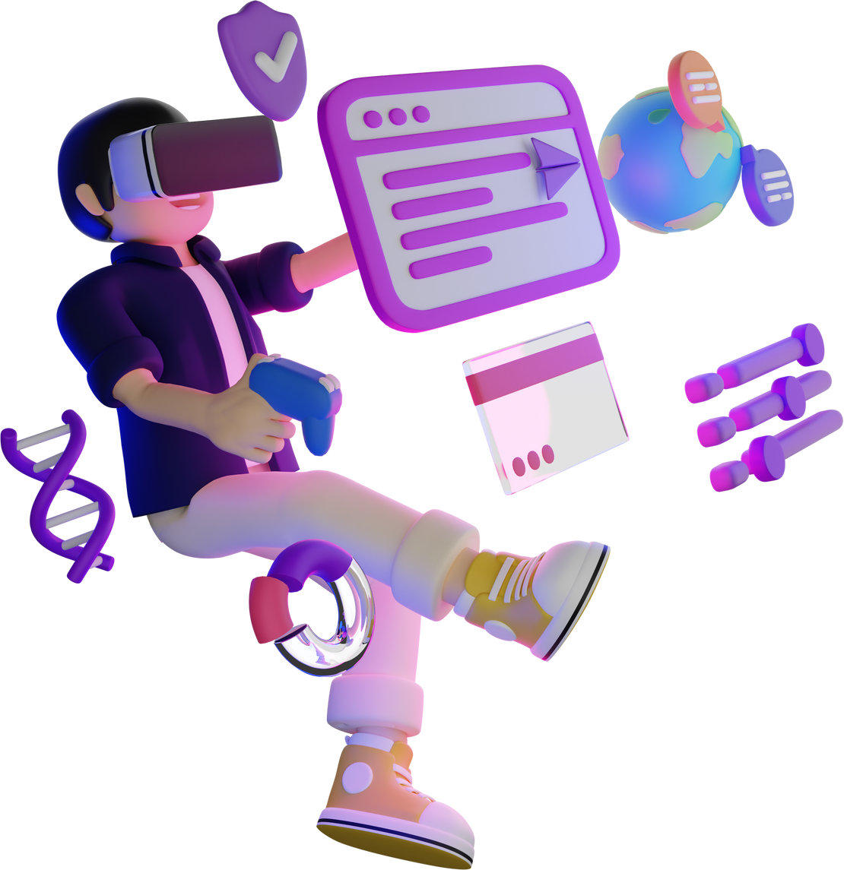

VIRTUAL REALITY

Slide 2
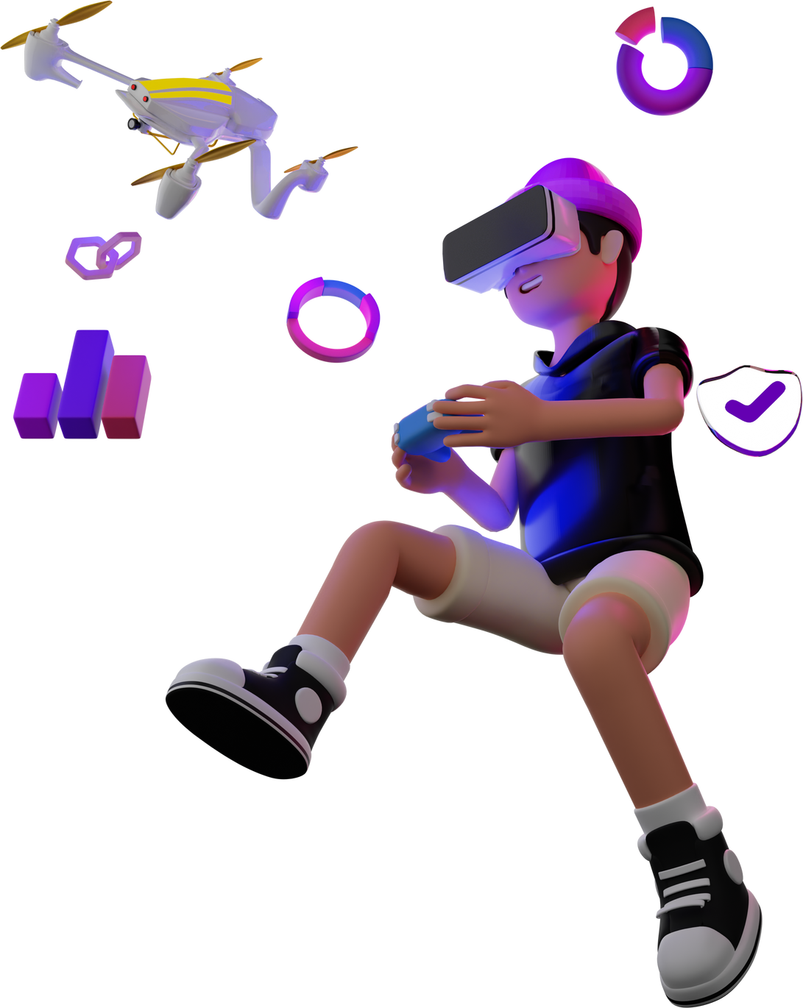
INTRODUCTION
What is VR?
Virtual Reality (VR) is a technology that creates a simulated environment or reality that can be similar to or different from the real world.
Users immerse themselves in a specifically designed simulated environment for a specific purpose.
These environments can range from realistic representations of real-world locations to entirely fictional or abstract spaces.

Slide 3
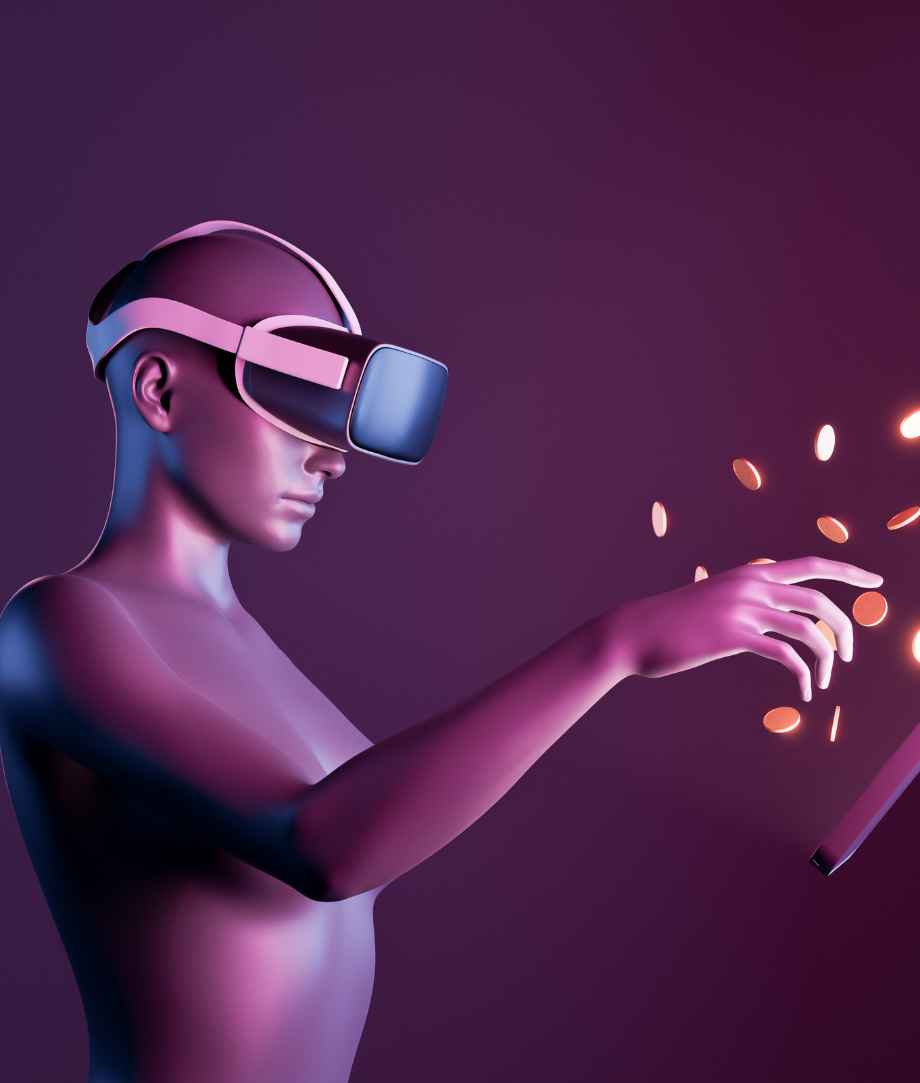
NEED OF VR
Virtual reality allows users to create simulated, interactive, and specifically designed environments for specific use.
It is designed for human interaction or for a specific reason to create experiences.
Unlike other reality technologies like AR and MR, VR enhances the user experience to the next level with its fully immersive and interactive technology.

Slide 4
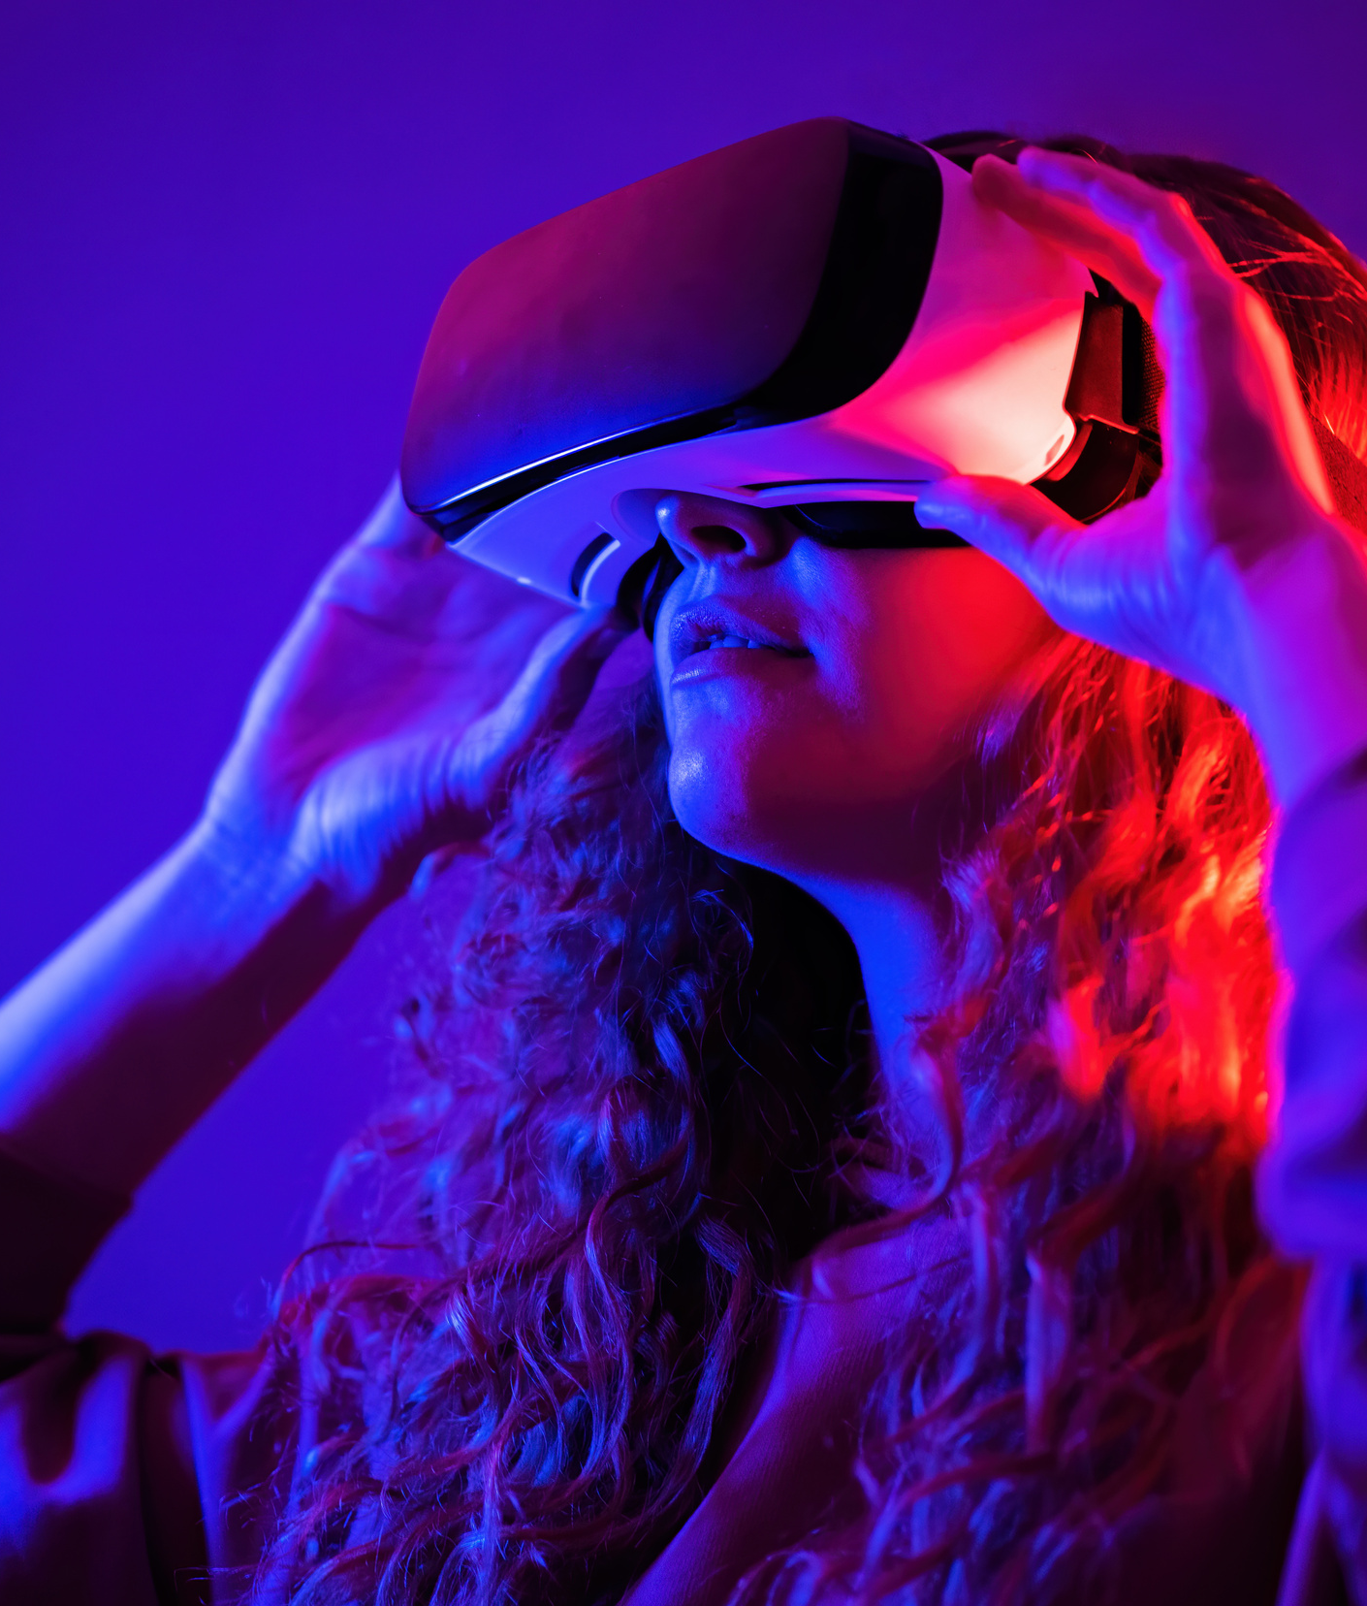
TYPES OF VR
Non-Immersive Virtual Reality
Fully IImmersive Virtual Reality
Semi-Immersive Virtual Reality
Collaborative VR
Augmented Reality AR

Slide 5
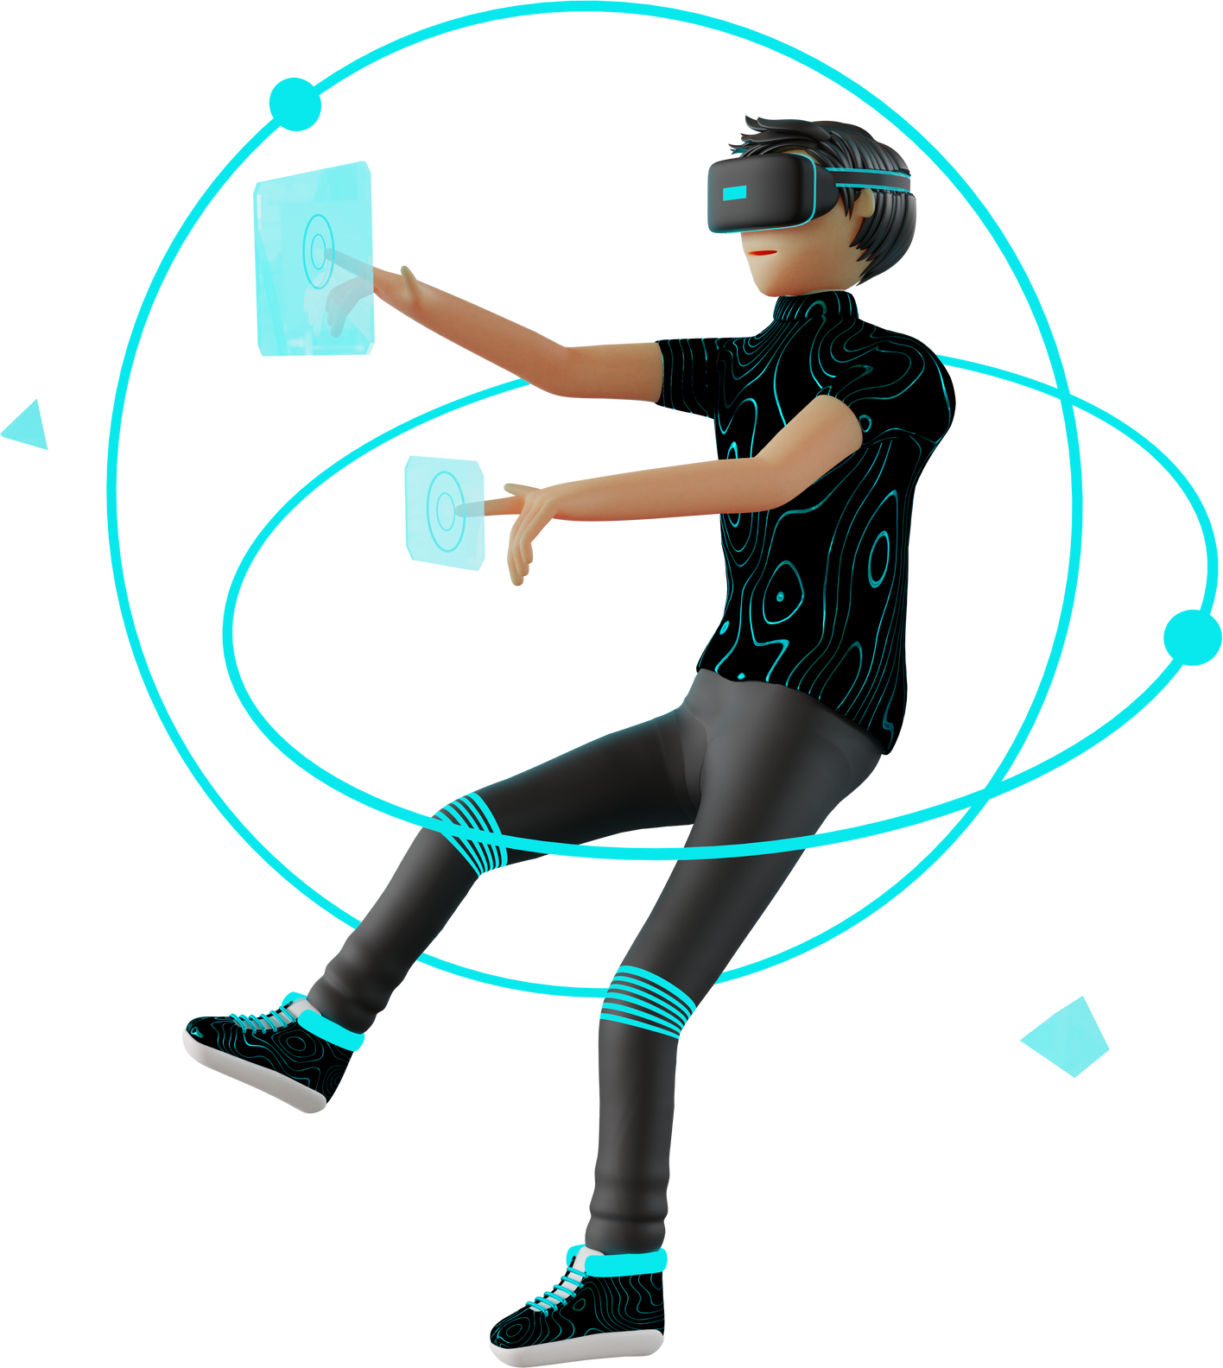
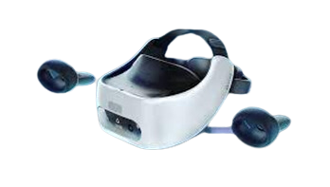
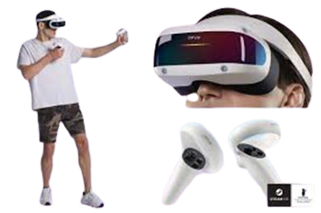
VR DEVICES
STANDALONE
TETHERED

Slide 6
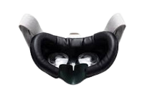
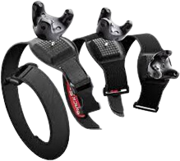
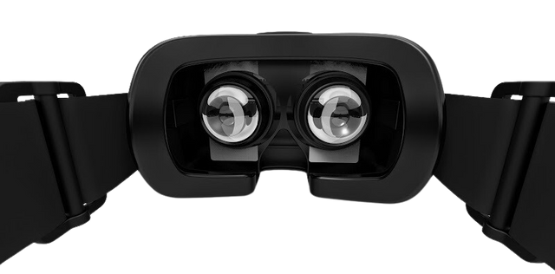
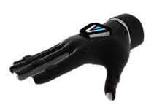
VR ACCESSORIES
VR COVERS
VR GLOVES
TRCKER OF BODY
VR LENSES

Slide 7
ADVANTAGES AND DISADVANTAGES OF VR
ADVANTAGES
DISADVANTAGES
Enhanced Customer Engagement
Improved Customer Retention
Streamlined Product Designs
Optimized Return on Investment (ROI)
Reduced Costs
Remote Connectivity
High cost
Compatibility Issues with Advancing Technology
Limited Content Availability
Health Concerns
Negative Effects of Isolation and Dependence on VR

Slide 8
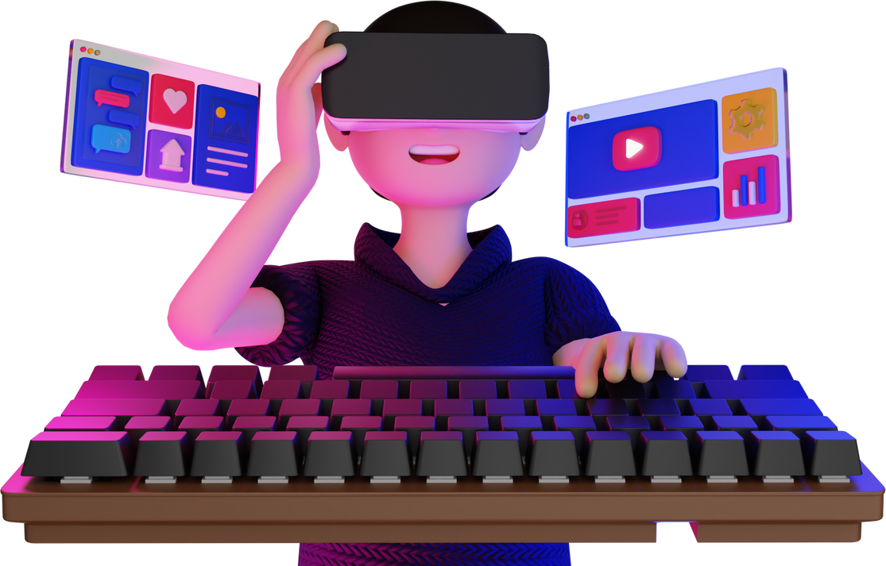
WHAT IS VR CONCEPT?
VR creates a simulated experience that can be similar to or different from the real world.
It typically involves wearing a head-mounted display (HMD) and may incorporate other sensory inputs.
It blurs the line between the physical and virtual realms, enabling users to perceive and interact with objects, characters, and environments.
Notes:
Nisarg

Slide 9
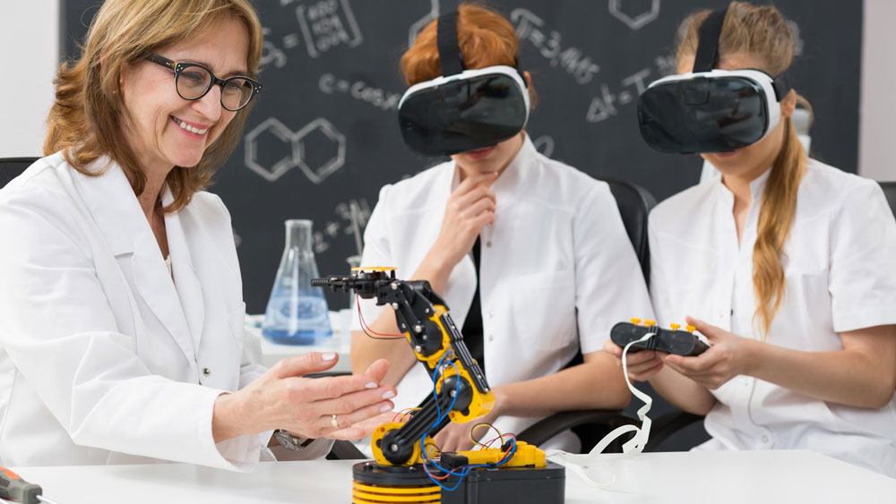
CONCEPT IDEA: EDUCATION PLATFORM
TARGET AUDIENCE: STUDENTS & LIFELONG LEARNERS
Better sense of place
Learning experiences at scale
Learning by doing
Emotional reaction
Creative development
Visual learning

Slide 10
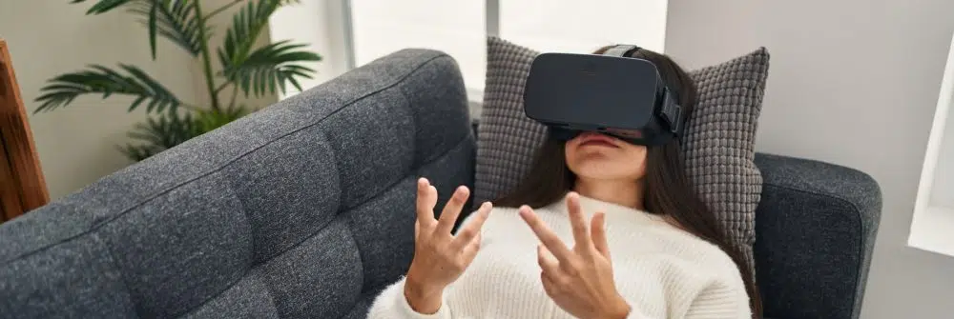
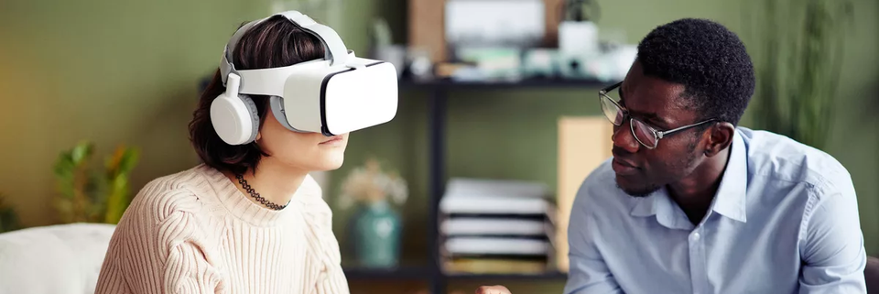
CONCEPT IDEA: THERAPY FOR MENTAL HEALTH
TARGET AUDIENCE: MENTAL HEALTH PROFESSIONALS AND INDIVIDUALS SEEKING THERAPEUTIC SUPPORT
FEATURES OF THE VR THERAPY
TARGET AUDIENCE AND BENEFITS
VR therapy for mental health support.
Immersive environments for alleviating mental health conditions.
Guided meditation and relaxation sessions.
Cognitive-behavioral therapy (CBT) modules.
User data tracking for treatment plans.
Individuals seeking therapeutic support.
Enhancement of traditional therapeutic approaches.
Alternative & immersive therapeutic experiences.
Improved engagement and motivation in therapy.
Integration of innovative technologies into mental health practice.

Slide 11
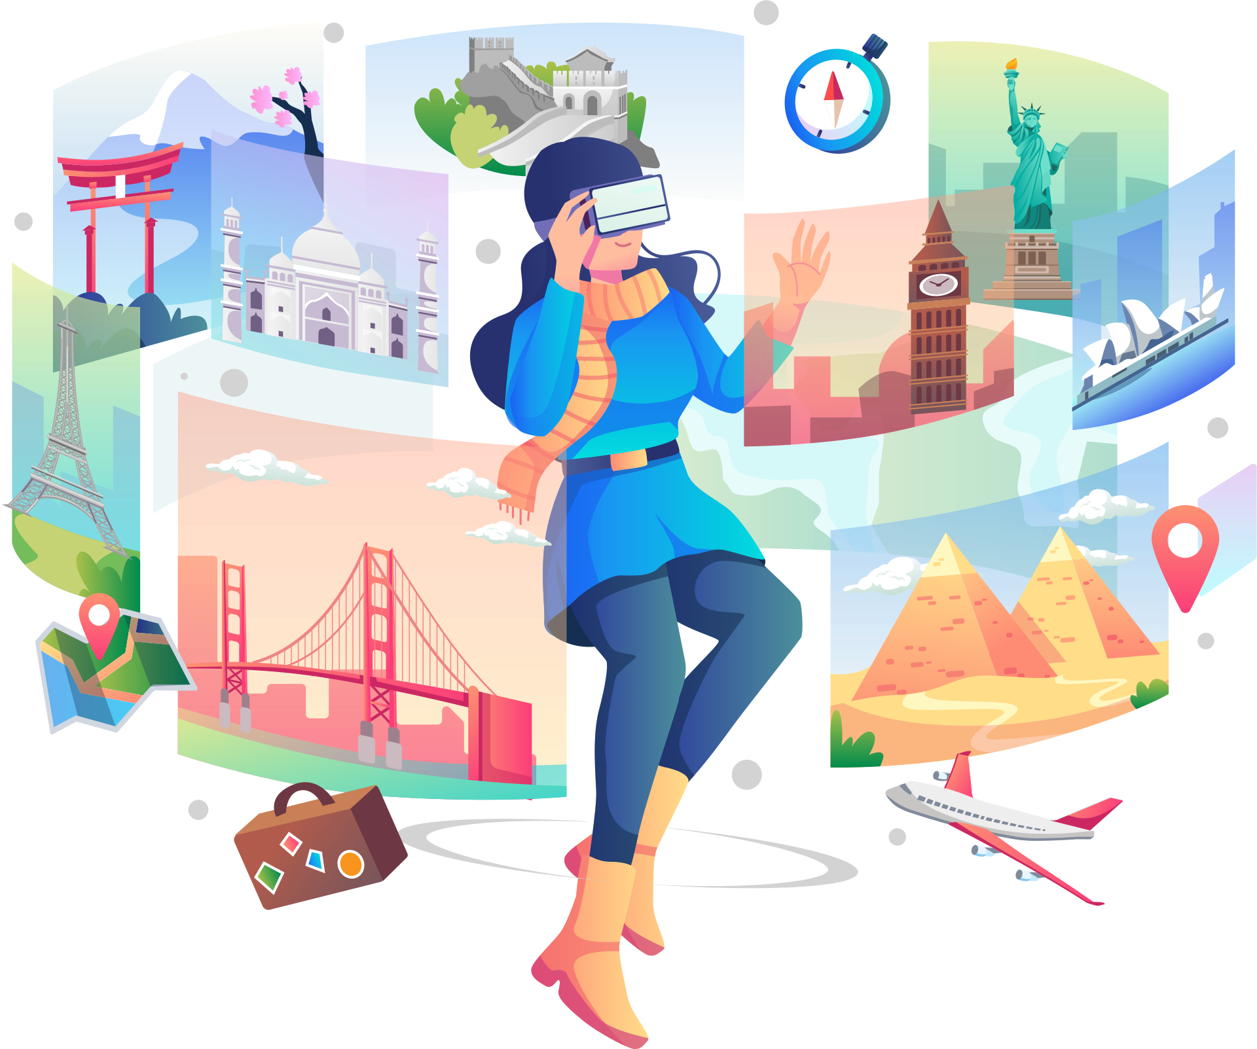
OTHER USE CASES OF VR
Gaming: Immersive and interactive gameplay in virtual worlds.
Training and Simulation: Realistic simulations for pilot training, surgical practice, and hazardous environment safety training.
Architecture and Design: Visualization of virtual buildings and spaces for architects and designers.
Virtual Tourism: Virtual tours of destinations and landmarks for immersive travel experiences.
Social and Communication: Virtual meetings, social gatherings, and collaborative environments.
Entertainment and Media: Enhanced storytelling, immersive cinema, and interactive experiences. Engineering and Manufacturing: Product design, prototyping, and assembly line optimization.

Slide 12
DEVELOPMENT PROCESS & APPLICATION

Slide 13
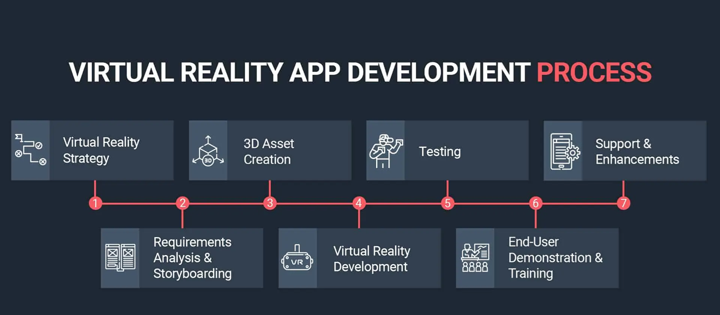

Slide 14
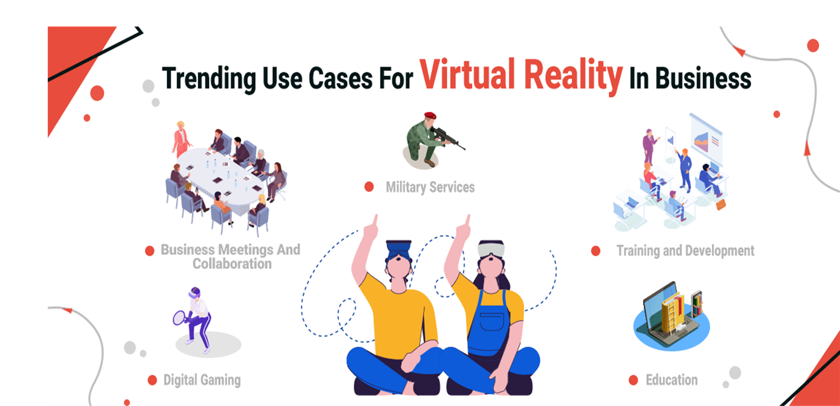

Slide 15
TECHNICAL REQUIREMENTS & DESIGN CONSIDERATIONS

Slide 16
Hardware Requirements
Development Environment
Software Frameworks and Libraries
VR Interaction and Input
Graphics and Rendering
Performance Optimization
Audio and Spatial Sound

Slide 17
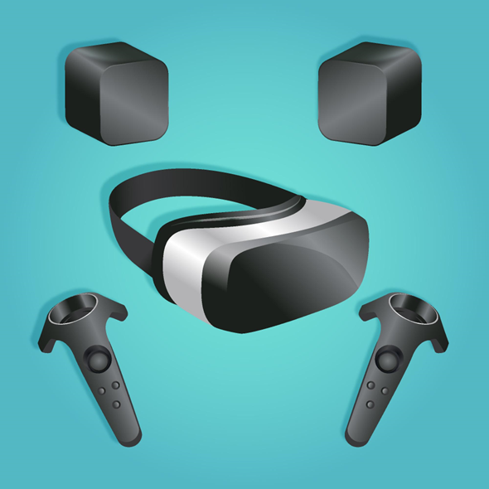
HARDWARE REQUIREMENTS
VR Headset: Choose a compatible VR headset that suits your target platform (e.g., Oculus Rift, HTC Vive, PlayStation VR, etc.).
PC or Console: Ensure that the development machine meets the recommended specifications for the VR headset and platform you're targeting.

Slide 18


DEVELOPMENT ENVIRONMENT
VR SDK: Select a software development kit (SDK) that supports the VR platform you're targeting (e.g., Oculus SDK, SteamVR, Unity XR, Unreal Engine VR, etc.).
Integrated Development Environment (IDE): Choose an IDE such as Unity or Unreal Engine, which provide VR development tools and assets.

Slide 19



SOFTWARE FRAMEWORKS AND LIBRARIES
•3D Modeling Software: Utilize software like Blender or Autodesk Maya for creating and animating 3D assets.
•Physics Engine: Employ a physics engine like PhysX or Bullet Physics to handle realistic interactions between objects in the virtual environment.

Slide 20
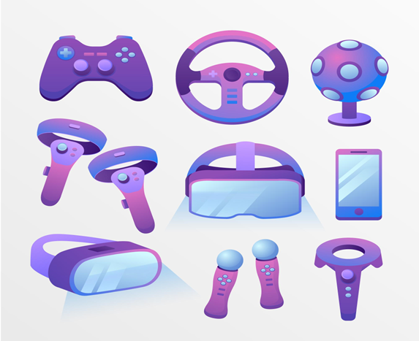
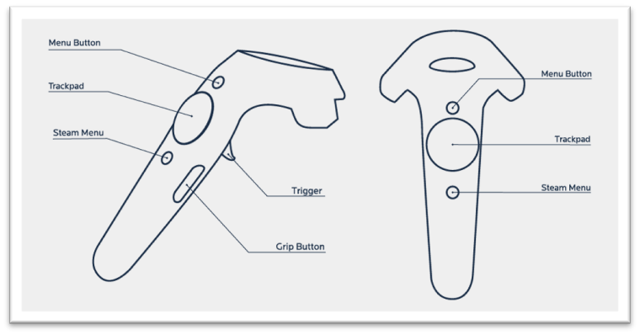
VR INTERACTION AND INPUT
•Controllers: Design and integrate support for VR controllers, enabling users to interact with objects in the virtual world.
•Hand Tracking: If supported by the VR platform, consider incorporating hand tracking technology for more natural interactions.
•Gesture Recognition: Implement gesture recognition algorithms to interpret user gestures and enable corresponding actions in the VR environment.

Slide 21

GRAPHICS AND RENDERING
•3D Graphics: Create high-quality 3D models, textures, and animations optimized for real-time rendering in the VR environment.
•Shading and Lighting: Utilize shaders and lighting techniques to achieve realistic visuals and enhance immersion.
•Stereoscopic Rendering: Implement rendering techniques that generate separate images for each eye to provide a stereoscopic 3D effect.

Slide 22
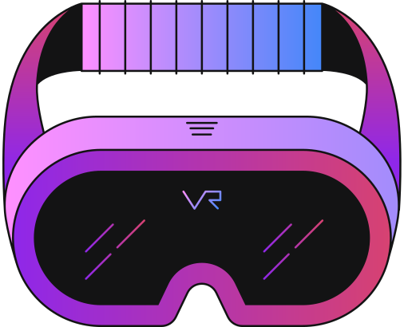
PERFORMANCE OPTIMIZATION
•Frame Rate: Maintain a consistent high frame rate (e.g., 90 FPS) to minimize latency and motion sickness.
•Level of Detail (LOD): Implement LOD techniques to optimize performance by rendering complex objects with fewer details when they are far away or not in focus.
•Occlusion Culling: Use occlusion culling algorithms to avoid rendering objects that are not visible to the user, improving performance.

Slide 23

AUDIO AND SPATIAL SOUND
•3D Audio: Implement spatial audio techniques to create a sense of depth and directionality, enhancing the immersive experience.
•Sound Effects: Use appropriate sound effects to provide audio feedback for user actions and environmental cues.

Slide 24
TESTING AND USER EXPERIENCE
•Testing: Regularly test the application on different VR hardware setups and platforms to ensure compatibility and optimal performance.
•User Experience (UX): Optimize the user interface and interactions to be intuitive and comfortable in the VR environment.

Slide 25
DESIGN CONSIDERATIONS

Slide 26
•User Comfort and Safety
•Intuitive User Interface and Interaction
•Immersive Environment and Presence
•Performance Optimization
•Iterative Testing and Feedback

Slide 27
MONETIZATION
AND
BUSINESS MODEL

Slide 28
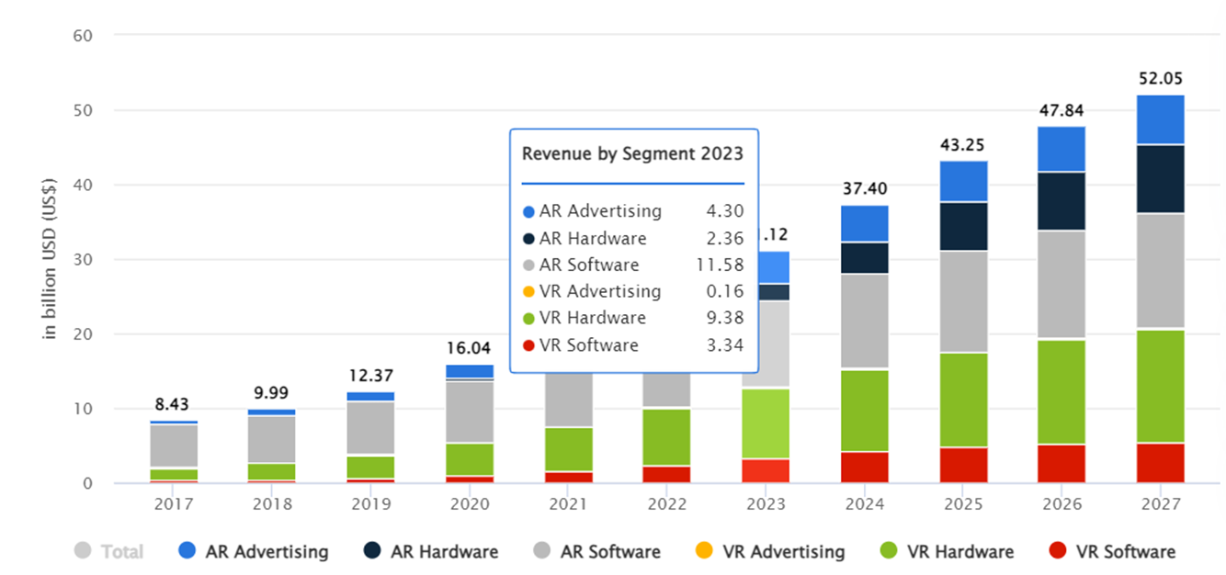
US$31.12 BILLION

Slide 29
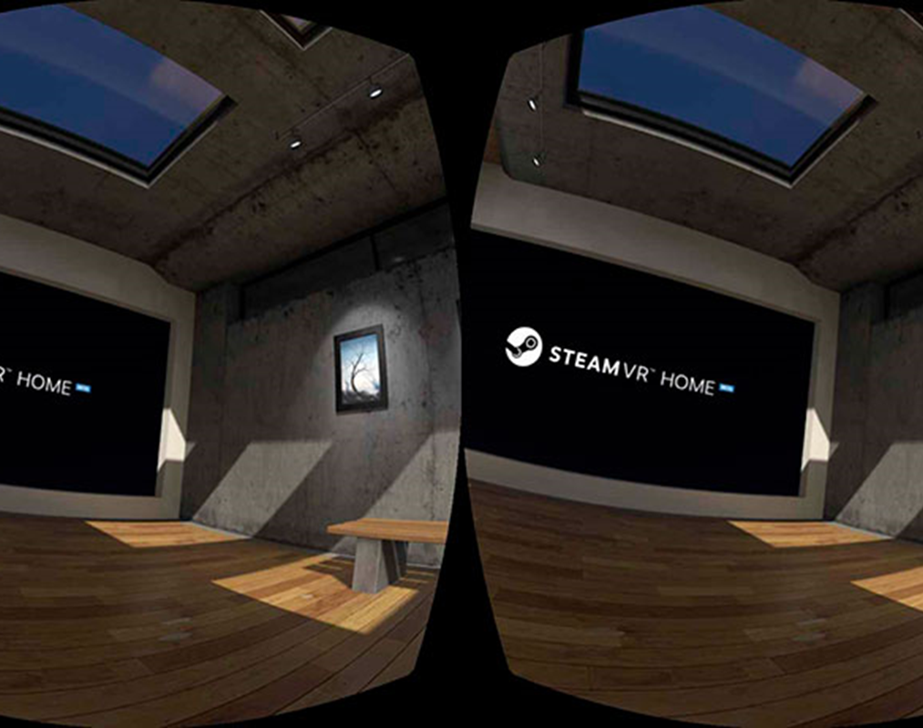
PAYMIUM (PAID-APPS)
The oldest and the most traditional business model
TrinusVR, for instance, is available for both iOS and Android for $9.99. With about 50K downloads across both, the app lets users play VR games on a PC without buying expensive hardware.

Slide 30

IN-APP PURCHASES (IAP)
Free downloading with in-app purchases
Buying characters, real-estate, avatars, etc in virtual reality
The big advantage of this type of monetization is that “people are willing to invest their time — rather than money — to try out a new app,”
Public Speaking VR designed by VirtualSpeech Ltd

Slide 31
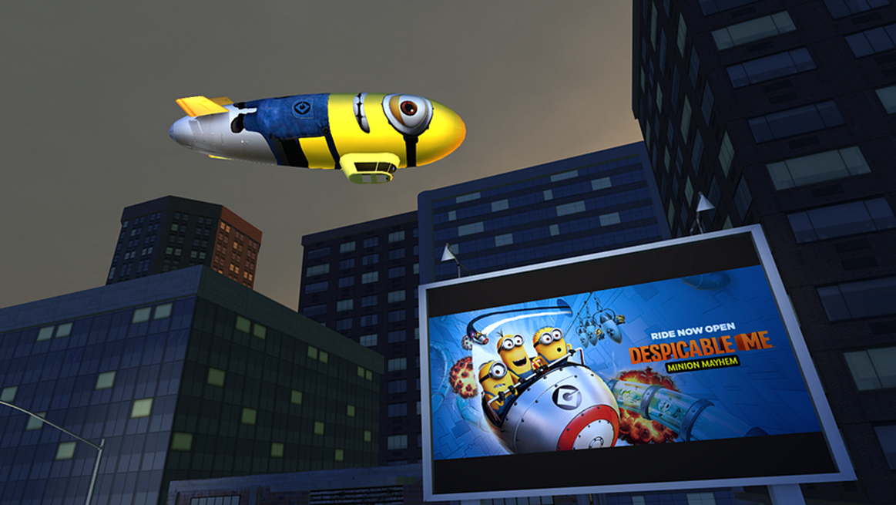
IN APP ADVERTISEMENTS
The most preferable monetization model
NYT VR, a virtual reality version of one of the world’s popular newspapers — The New York Times, that has over 500,000 installs in app stores uses a pure advertising model.

Slide 32
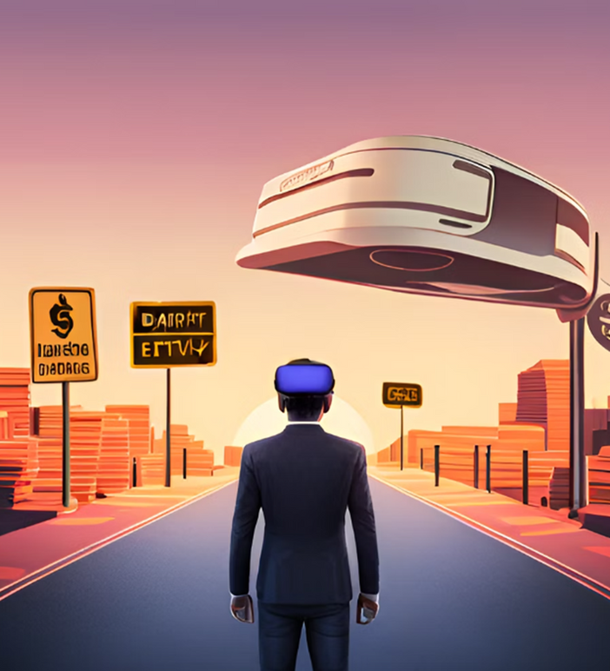
CHALLENGES & RISKS
Limited Realism: Difficulty achieving true photorealism and realistic physical interactions.
High Cost: Expensive equipment and systems, limiting accessibility.
Technical Limitations: Processing power, latency, and resolution constraints.
Content Availability and Quality: Limited selection and varying quality of VR experiences.
Ethical and Social Implications: Privacy, data security, and psychological effects.

Slide 33
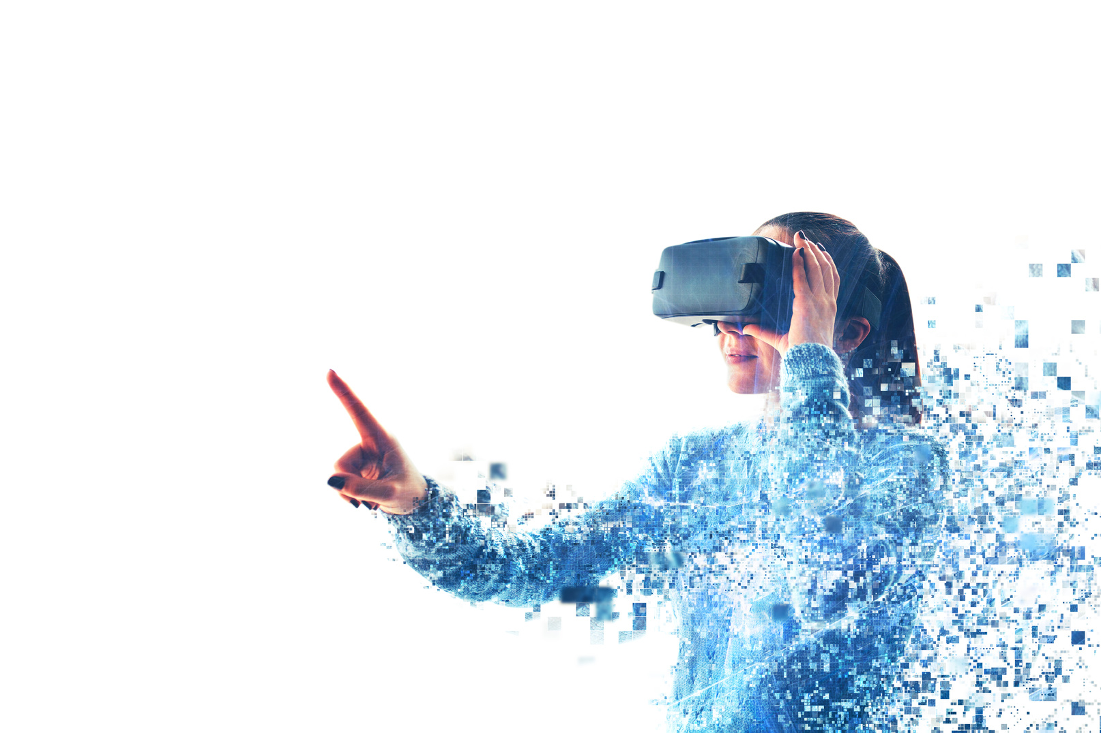
CONCLUSION
Virtual Reality (VR) is an exciting and transformative technology that offers immersive and interactive experiences in a virtual world
With advancements in technology, VR is becoming increasingly accessible, offering more affordable and high-quality experiences. It has the potential to revolutionize various industries by enhancing learning, training, design, communication, and entertainment.

Slide 34
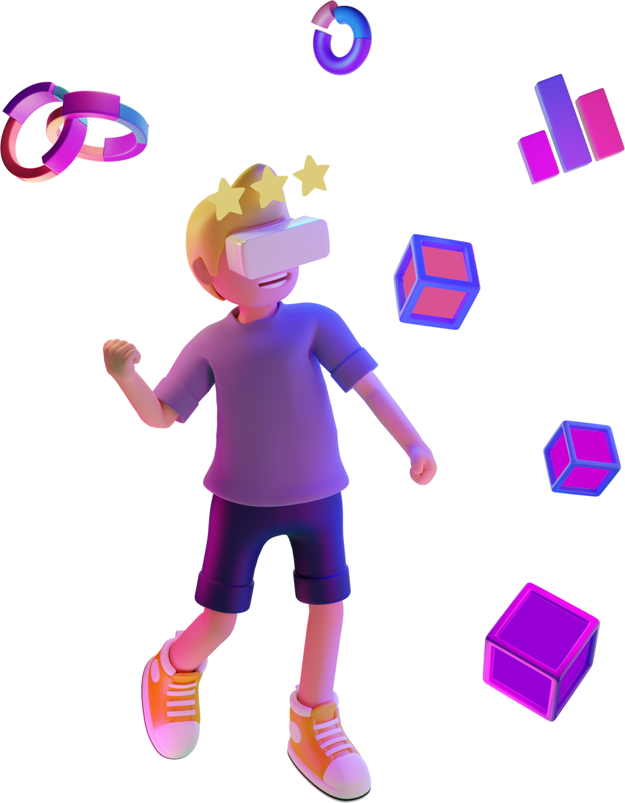
THANK YOU FOR YOUR ATTENTION

